Slide 1

过关测试卷
模块八 第二章 测试卷

Slide 2
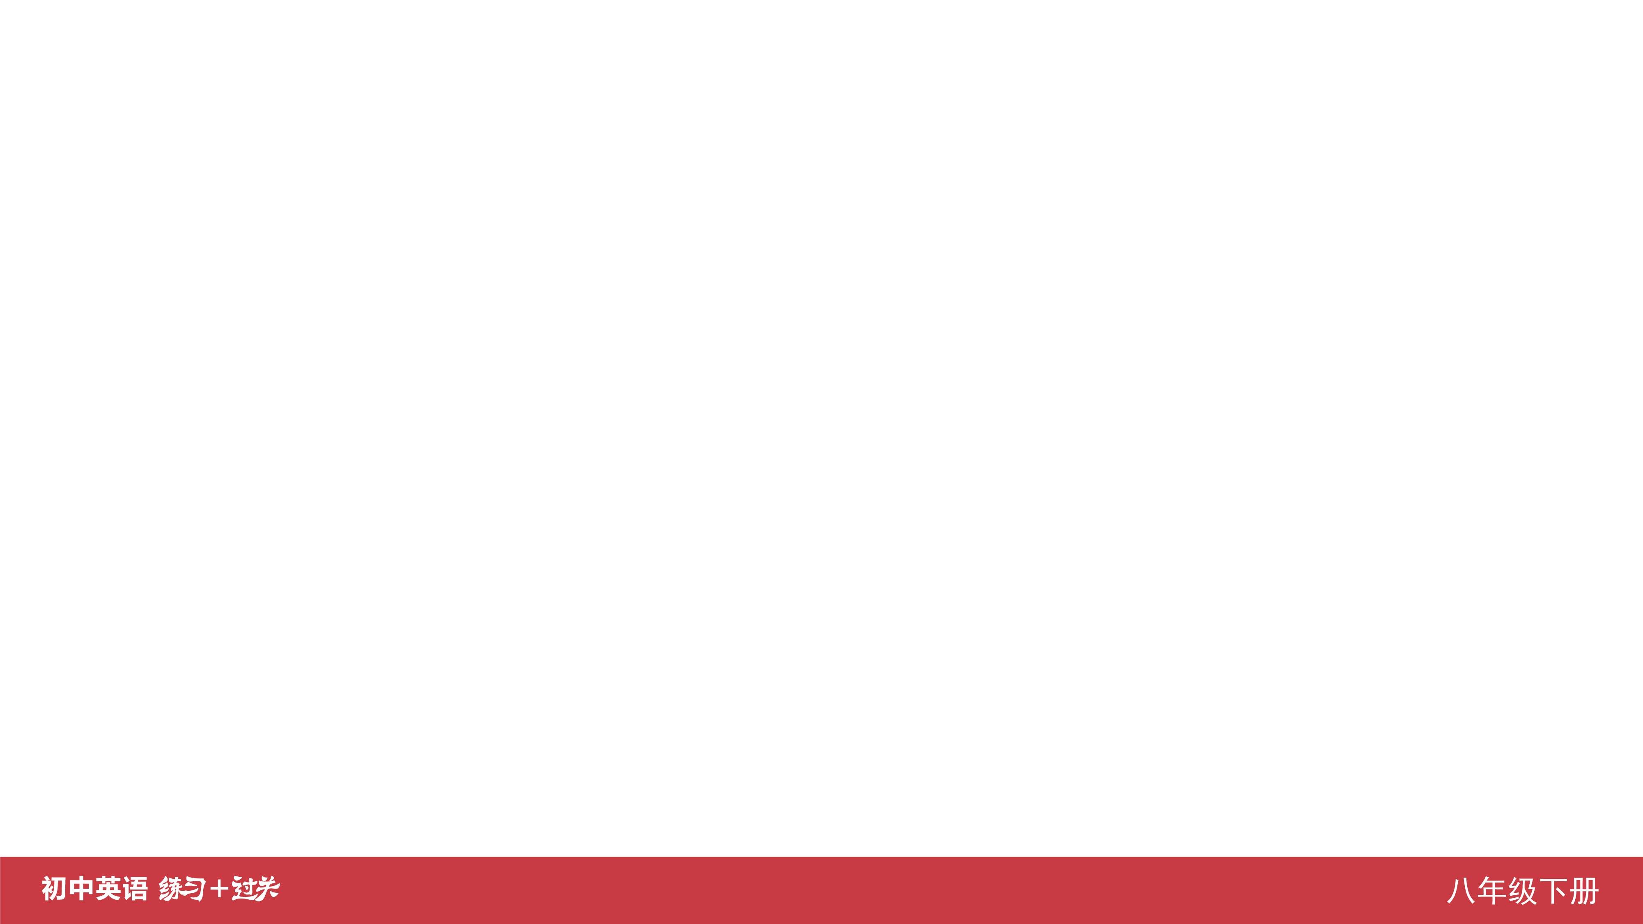
Ⅰ. 听力
1-5 ____________
6-10 ____________
11-15 ____________
16 ____________
17 ____________
18 ____________
19 ____________
20 ____________
ACABA
BBCBA
BBCCC
quiet
eat
coffee
reading
earlier

Slide 3
Ⅱ. 选择填空
21-25 ____________
26-30 ____________
31-35 ____________
ACACC
ABCBC
ABACC

Slide 4
Ⅲ. 完形填空
36-40 ____________
41-45 ____________
CABCB
BCACC

Slide 5
Ⅳ. 阅读理解
46-50 ____________
51-55 ____________
56-60 ____________
61-65 ____________
66-70 ____________
CBABD
BCCDC
DCBAD
CABCD
EACBD

Slide 6
Ⅴ. 情景交际
71. ____________________________________________
72. ____________________________________________
____________________________________________ 73. ____________________________________________
Could you tell me what kind of clothes you like best?
It’s necessary (for us) to keep quiet in the library./
It’s necessary that we keep quiet in the library.
Bruce, you look cool in this/that jacket.

Slide 7
Ⅴ. 情景交际
74. ________________________________________
________________________________________
________________________________________ 75. ________________________________________
________________________________________
Excuse me, how much is this book?/
Excuse me, what’s the price of the book?/
Excuse me, how much does the book cost?
Whether we will go fishing tomorrow depends on the weather.

Slide 8
Ⅵ. 看图写话
76. ____________________________________________
____________________________________________
77. ____________________________________________
____________________________________________
78. ____________________________________________
It’s impolite that they fight with each other./
It’s impolite for them to fight with each other.
The nurse is looking after/looks after the patient/
old lady carefully.
It’s important to wear sports shoes when running.

Slide 9
Ⅵ. 看图写话
79. _________________________________________
_________________________________________
80. _________________________________________
The man took off his shoes when he entered the room.
Lucy/Lily plays the piano as well as Lily/Lucy.

Slide 10
Ⅶ. 短文填空
are
a
nothing
but
forgot
81 ____________
82 ____________
83 ____________
84 ____________
85 ____________
as
ourselves
perfect
heart
better
86 ____________
87 ____________
88 ____________
89 ____________
90 ____________

Slide 11
Ⅷ. 书面表达
My Favorite School Uniform
At school, we have to wear school uniforms. But most of
my classmates don’t like wearing them. They think the school uniforms are ugly and uncomfortable. Here are my suggestions for our uniforms.

Slide 12
Ⅷ. 书面表达
I hope our school can take my advice and design the uniforms we like.
First, school uniforms should be in modern style. We’ll feel more confident if we wear clothes in fashion. Second, they had better be in light colors instead of dark ones. Light colors make students look more active and beautiful. Third, they should be made of cotton because cotton clothes are soft and comfortable, especially in summer.

Slide 13


